Slide 1
2020
Year Monthly Calendar

Slide 2
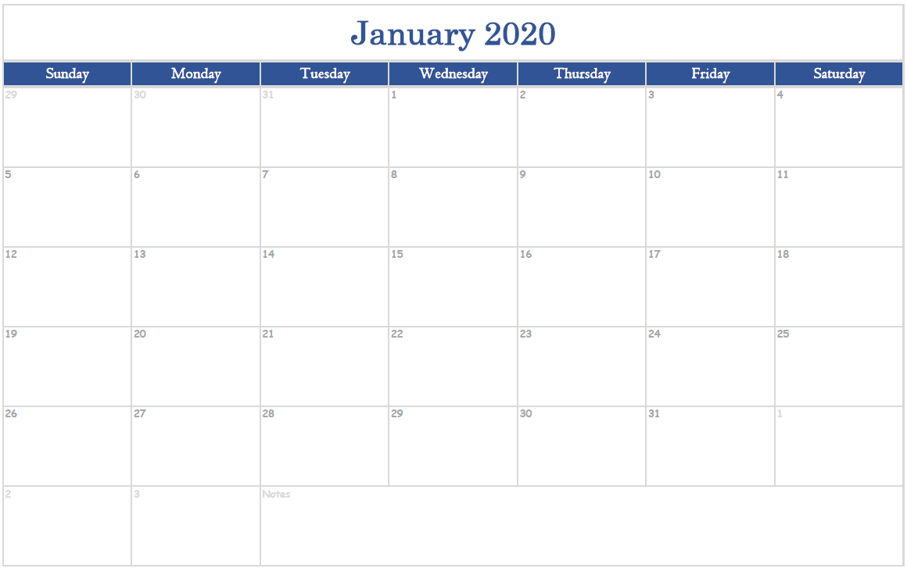
JANUARY
2020

Slide 3
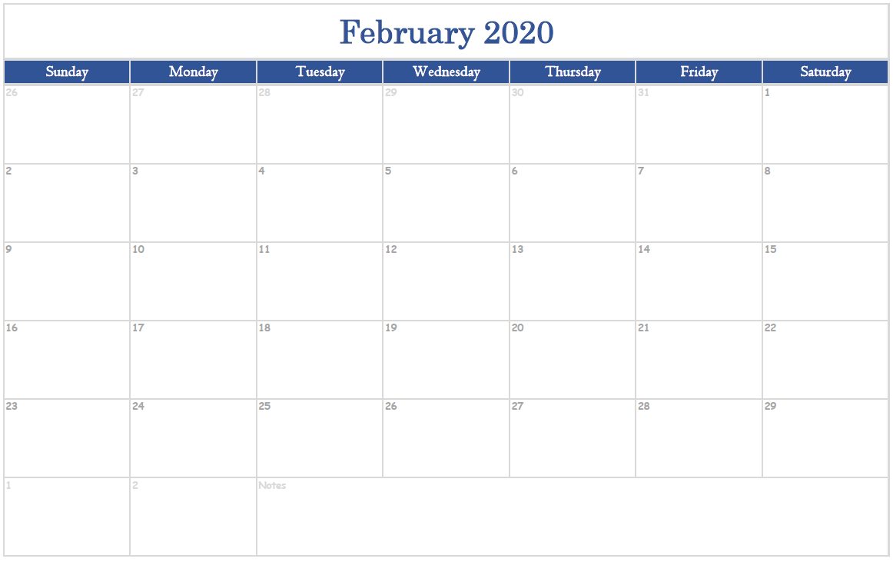
FEBRUARY
2020

Slide 4
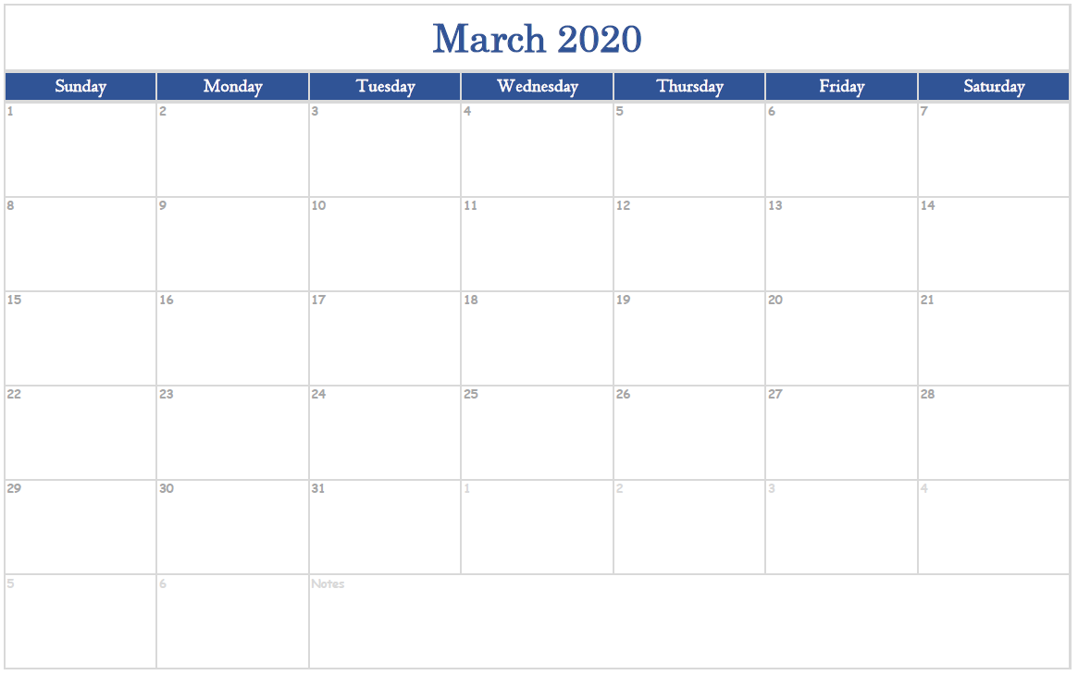
MARCH
2020

Slide 5
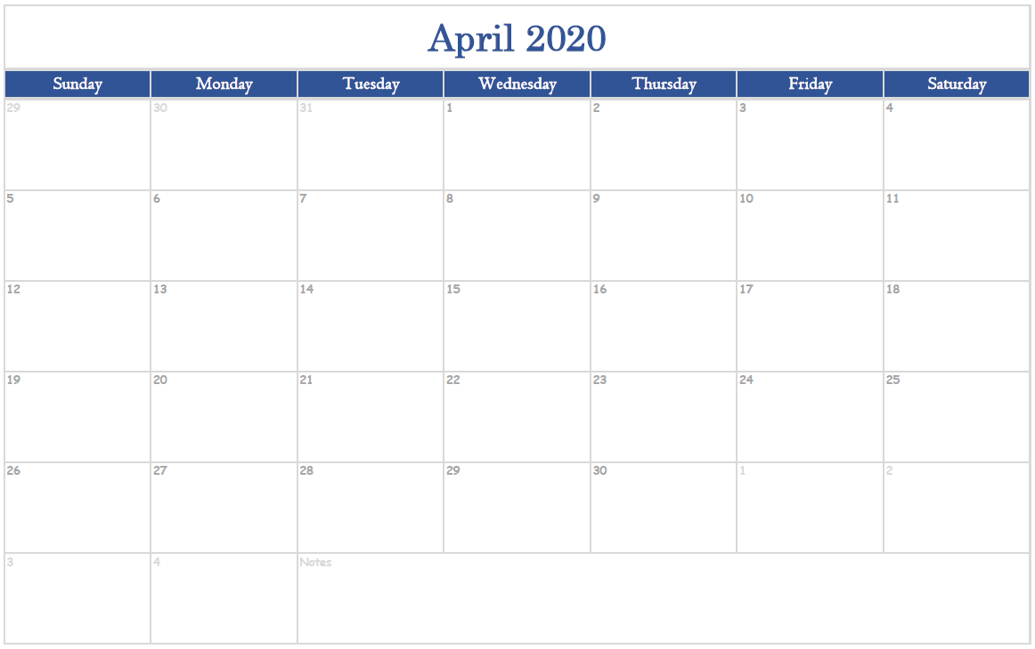
APRIL
2020

Slide 6
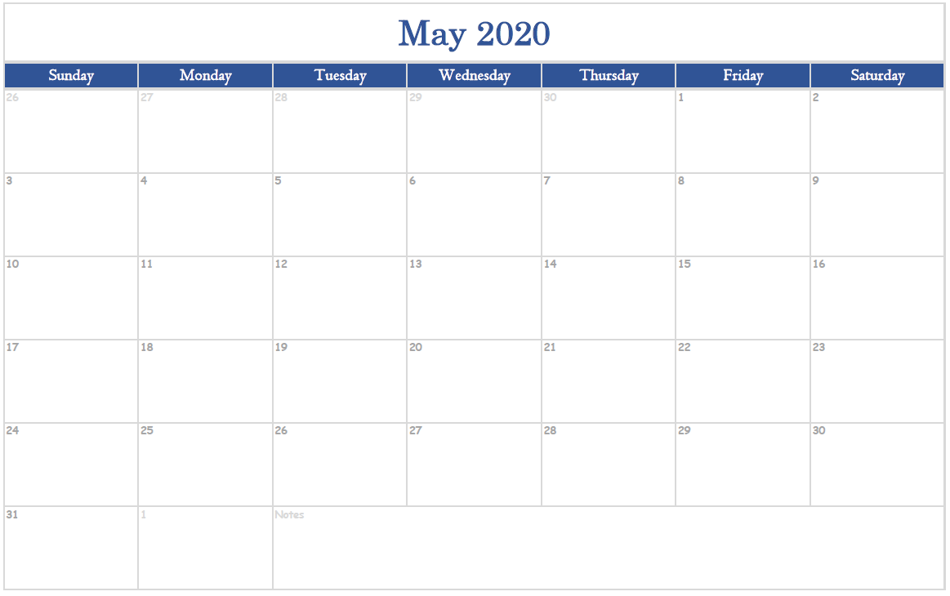
MAY
2020

Slide 7
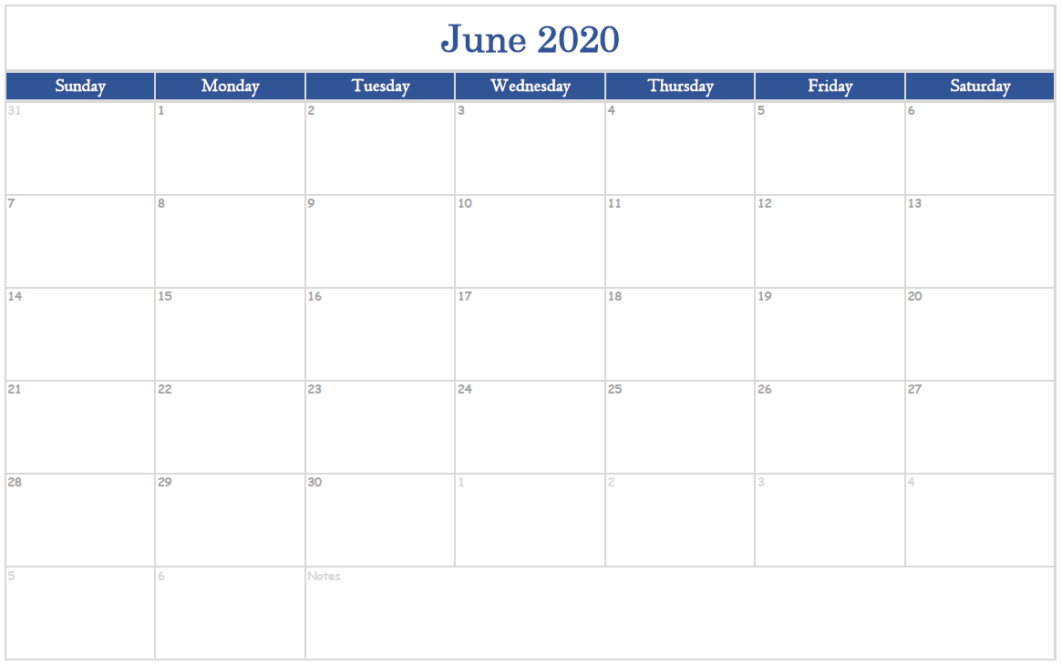
JUNE
2020

Slide 8
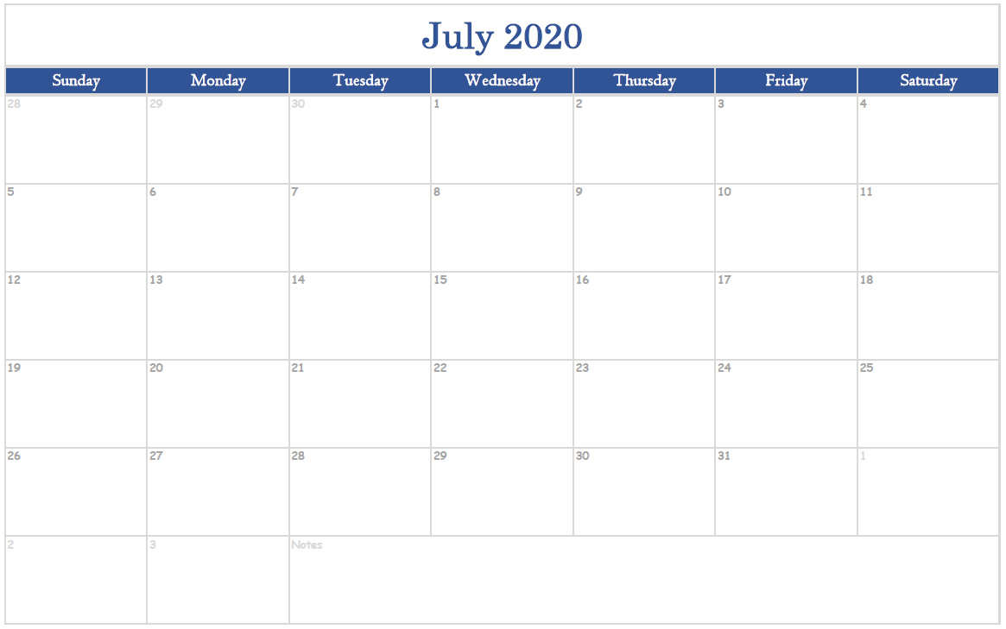
JULY
2020

Slide 9
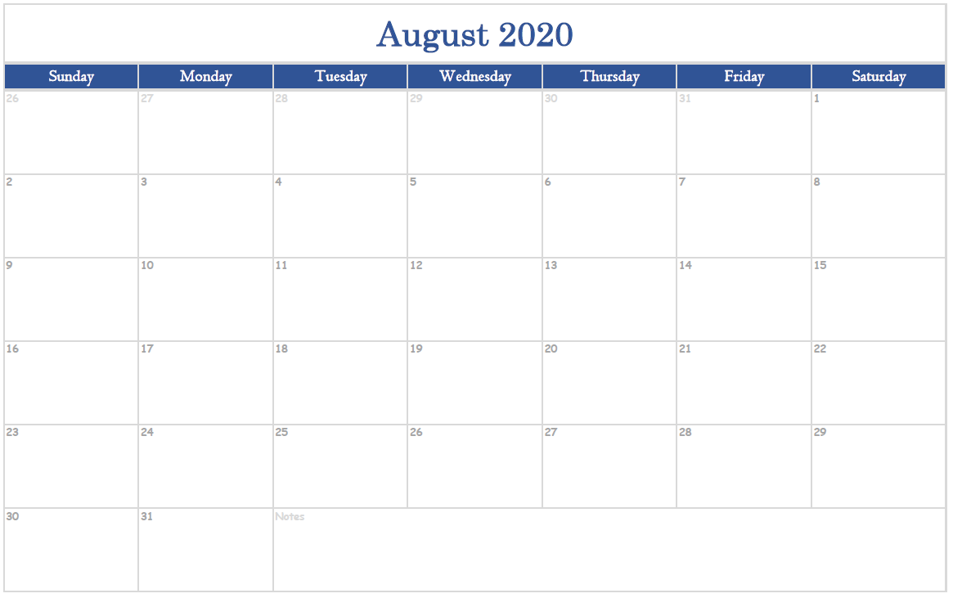
AUGUST
2020

Slide 10
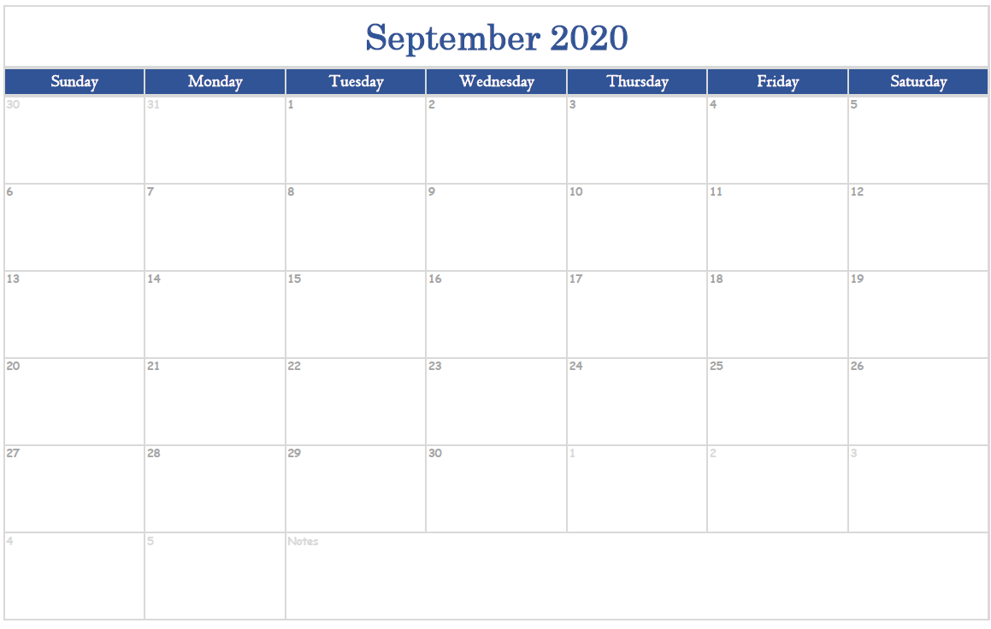
SEPTEMBER
2020

Slide 11
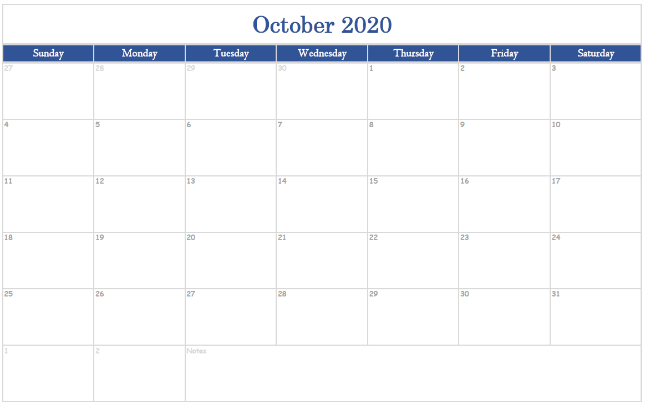
OCTOBER
2020

Slide 12
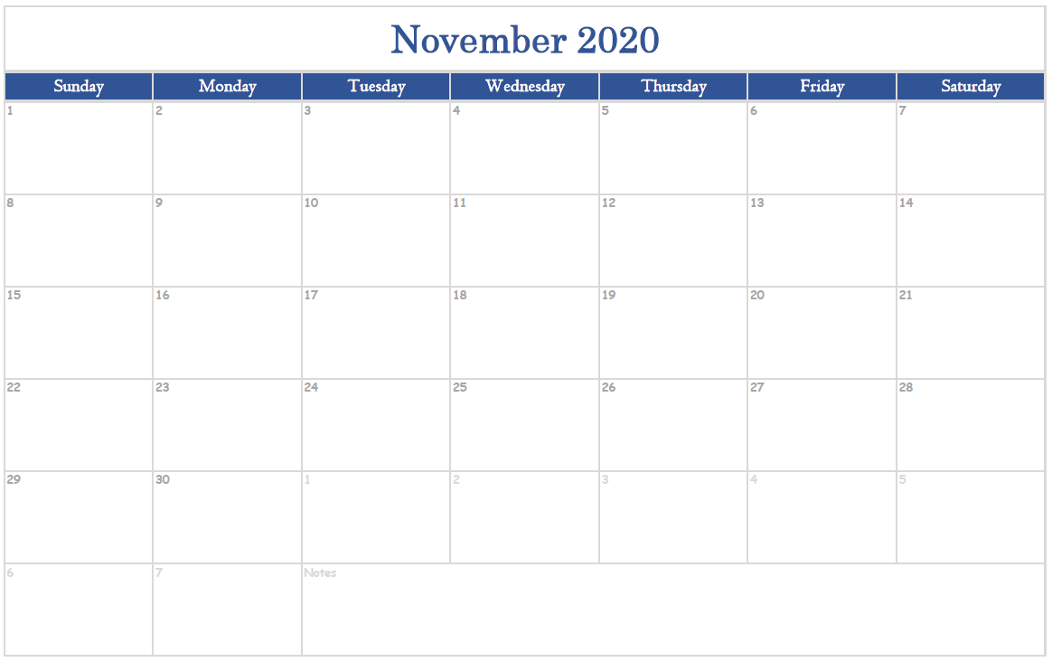
NOVEMBER
2020

Slide 13
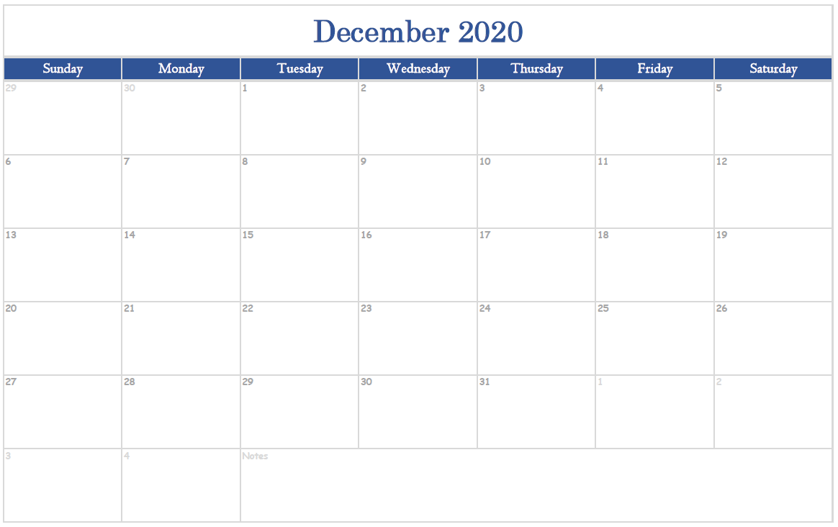
DECEMBER
2020

